Slide 1
Analysis and Interpretation of Ornithological Citizen Science Data and USDA Agricultural Census Data: Grassland Bird Species
Mike Andersen
MA3775@drexel.edu
DSCI521 Section 900

Slide 2
Project Background: Grassland Birds
Why is this topic important?
40% decline in grassland species since 1966
Significant vulnerability of grassland species to habitat loss
Species rely on tallgrass, mixed grass, and shortgrass prairies heavily
Habitat loss due to climate change, conversion of habitat to cropland
Urgent need to assess land usage and identify opportunities for conservation, habitat protection, restoration
Audience: policy-makers, agricultural industry, conservation organizations
https://www.audubon.org/conservation/working-lands/grasslands-report#

Slide 3
Project Background: Dataset Origins
Constructed manually from two sources using python/SQL/AWS pipeline as part of Udacity Data Engineering capstone project
eBird (Requested data for each species, continental USA, year 2017)
USDA Agricultural Survey (downloaded from USDA)
Processed, cleaned, and merged data into star schema
Observation Fact Table: bird observation ID, species ID, observation count, FIPS
Agricultural Dim Table: various species from agricultural census (described later)
FIPS Dim Table: geographic information table providing county names
Sampling Event Dim Table: details of observation sampling checklist, such as latitude/longitude, observer id, observation date, etc. (excluded)
Taxonomy Dim Table: common name, scientific name, taxonomic order (excluded)
Species were selected for download by eBird based on subject matter knowledge and guidance from Audubon 2019 Grassland Report. 16 species were included in this analysis, but there are significantly more grassland-dependent species with critical conservation status. The primary bottleneck was data processing resources (>3 million rows current)

Slide 4
Project and Dataset Scope
General Scope of Data:
Temporal: 2017
Geographical: Continental USA
Ornithological (eBird) Data
Species: Northern Bobwhite, Horned Lark, Upland Sandpiper, Grasshopper Sparrow, Baird’s Sparrow, Long-billed Curlew, American Pipit, Killdeer, Sprague’s Pipit, Lapland Longspur, Vesper Sparrow, House Sparrow, Red-winged Blackbird*, Bobolink, Snow Bunting, Song Sparrow*, Eastern Meadowlark (* = control species)
Date of observation not included: temporal/time-series not in scope for this analysis
Agricultural Census Measurements Included
Land in Farms, Irrigated Land in Farms, Cropland in Farms, Harvested Cropland in Farms, Pastureland in Farms, Conserved Land in Farms, Cropland and Pastureland Treated with Animal Manure, Cropland Treated to Control Insects, Cropland Treated to Control Nematodes, Cropland Treated to Control Weeds/Grass, Cropland Treated to Control Growth, Cropland Treated to Control Disease
A note on limitations:
Citizen Science data is vetted by official experts at the county level, there is an intrinsic bias of the data as areas with higher populations will inherently have more checklists, thus higher populations
Potential workaround is using population frequencies (percentage of checklists which contain a given species), however for this to work a complete dataset of every checklist in the date range/geographical scope is needed. Not feasible at the current scale and resources.

Slide 5
Core Question 1: Habitat Preference
Are certain species observed in higher quantities in regions with more pastureland, cropland, irrigated land, or land in farms?
Impact: understanding which species appear to favor pastureland, farmland, cropland, or irrigated land as habitat can drive locality of conservation efforts
Approach: correlation analysis (aggregated) and linear regression modeling (full, d=3)
Hypothesis Development (Based on EDA)
Many species rely on native grasslands for food and shelter. Where cropland replaces native grasslands, populations will decrease. Thus, a negative correlation between cropland and these species is expected. Some species prefer and benefit from farmland and cropland habitat, thus a positive correlation would be expected.
Similarly, land in farms is a broader terminology (includes cropland and pastureland). Generally, it is still expected that species which rely on native grasslands will exhibit negative correlations with land in farms. Some species prefer and benefit from farmland and cropland habitat, thus a positive correlation would be expected.
Pastureland maintains environmental characteristics of native grasslands and has significantly higher wildlife value, e.g., suitable habitat for grassland birds. Populations of species which rely on these natural habitats are expected to have a positive correlation with land in pastures.
Irrigated land is farmland which is irrigated with water as opposed to relying on rain. A potentially expected correlation is that shorebirds which breed in agricultural, or grassland settings will prefer this type of farmland, thus exhibit a positive correlation.

Slide 6
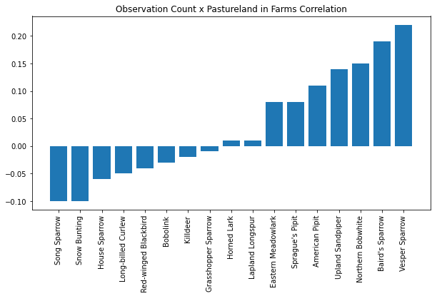
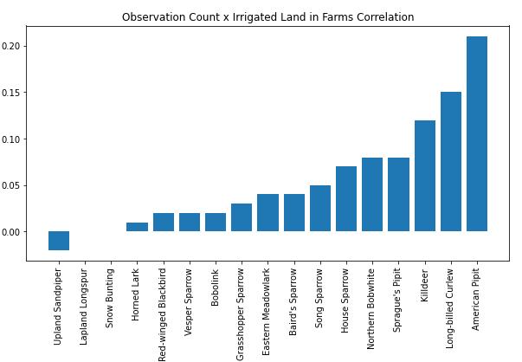
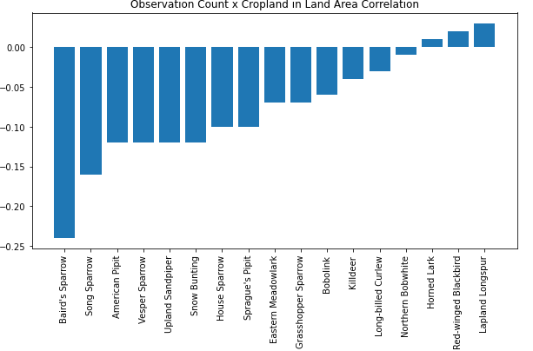
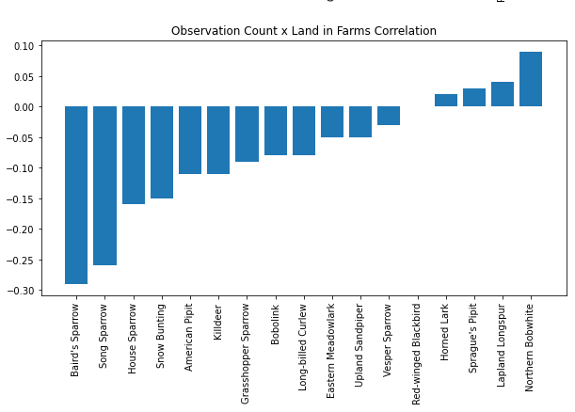
Habitat Preference: Correlations

Slide 7
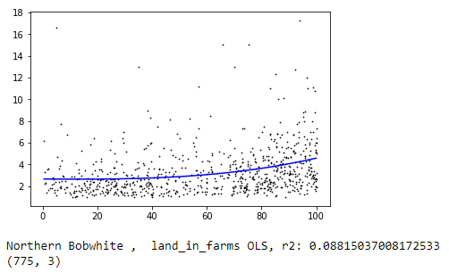
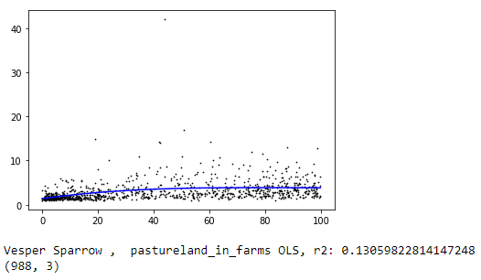
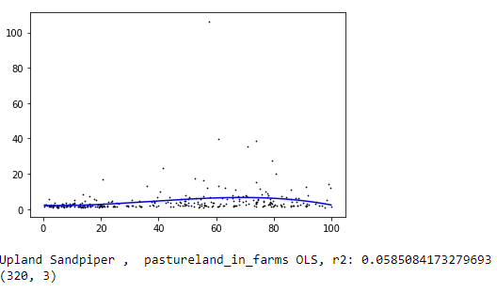
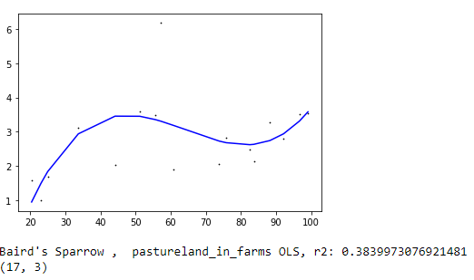
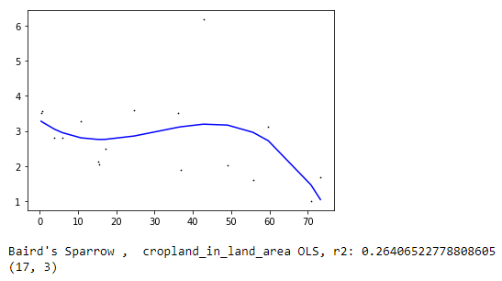
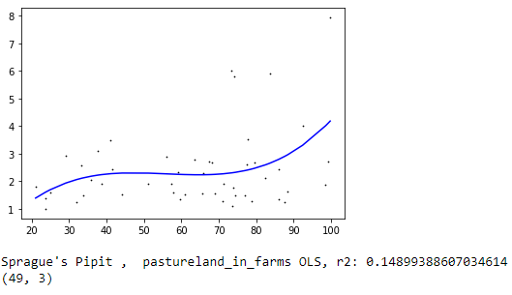
Habitat Preference: Select LR Results

Slide 8
Habitat Preference: Results Discussion
Pastureland as a Preferred Habitat
Vesper Sparrow, Baird’s Sparrow, Northern Bobwhite positive correlation
Linear Regression loosely confirms for each + Sprague’s Pipit exhibits relationship
Farmland Impact on Populations
Most grassland species correlation is negative with this measurement, with exception of Northern Bobwhite which exhibited positive correlation
Loose relationship via linear regression confirms negative correlations, with exception of Northern Bobwhite, as expected based on correlation analysis
Northern Bobwhite appears to increase with increased farmland, scientifically sound based on description of habitat by Audubon Society
Cropland Impact on Populations
Unanimous negative correlation with this measurement with exception of few species (Lapland Longspur, Horned Lark thrive in agricultural settings)
Most significant regression result was Baird’s Sparrow (small sample set = likely bias)
Irrigated Land as a Preferred Habitat
Most species exhibited positive correlation with this measurement with the exception of Upland Sandpiper
No significant results from regression analysis
Takeaways:
Pastureland is valuable habitat for species such as Vesper Sparrow, Baird’s Sparrow, and Northern Bobwhite. If possible, pastureland should be incentivized over cropland in breeding range of these species.

Slide 9
Core Question 2: Chemical Use
Do species observation quantities exhibit any relationship with use of chemicals used to treat insects, nematodes, growth, weeds/grasses, or disease?
Impact: understanding dynamics of populations and potential relationships with chemical use on cropland could help bring hidden complexities to light
Approach: correlation analysis and linear regression modeling
Hypothesis Development (based on EDA):
Potential exists for a relationship between percentage of cropland treated to control insects and observation counts. One could hypothesize that areas treated more to control insects would have a higher population of insectivorous species. Alternatively, the opposite could be true if treatment has already depleted the insect population in a given county.
Potential also exists for a relationship between percentage of cropland treated to control weeds/grasses and observation counts. Areas treated to control weeds and grasses should in theory have a negative correlation with grassland-dependent species, since the treatment removes their preferred habitat.
Examination of use of chemicals to control nematodes and disease.

Slide 10
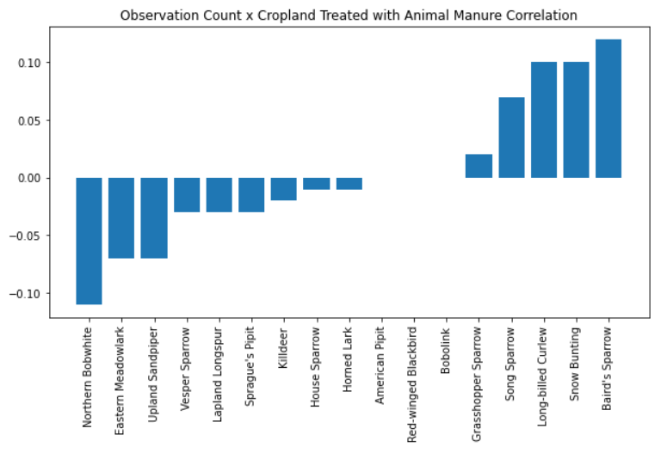
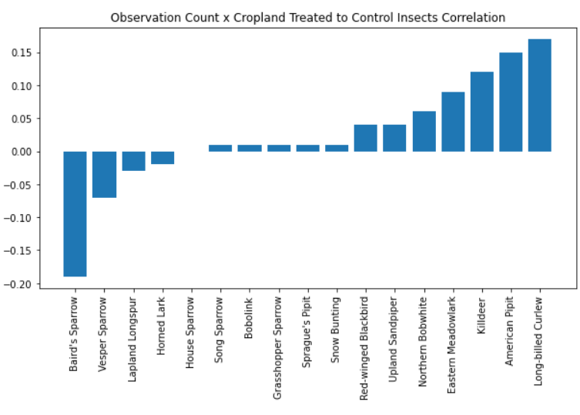
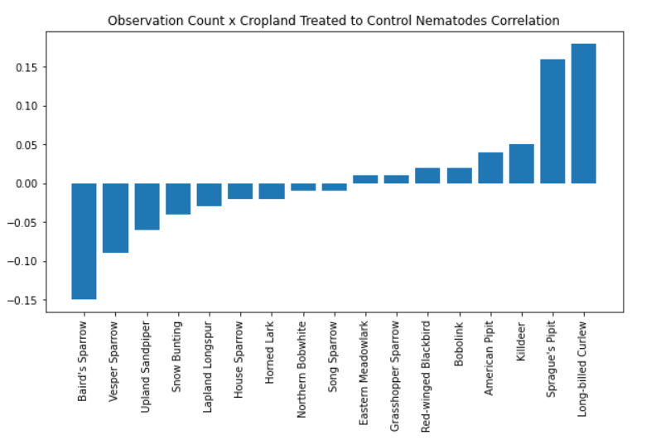
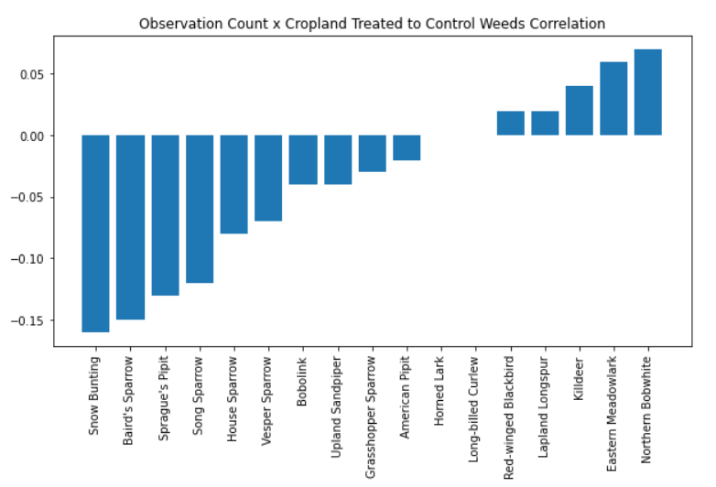
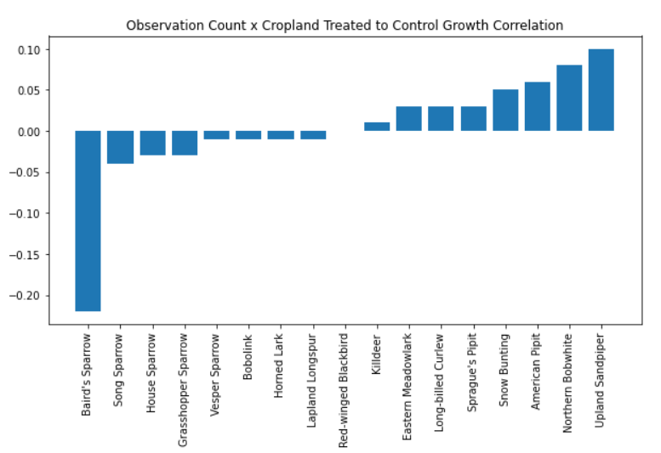
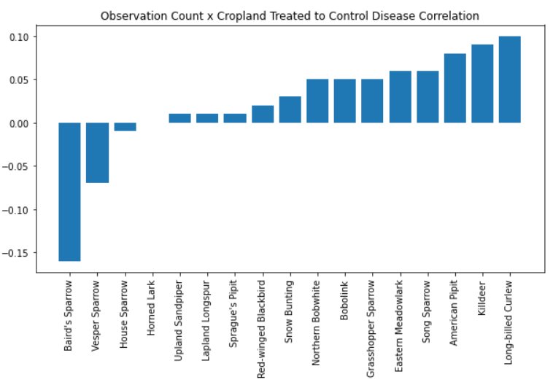
Chemical Use: Correlations

Slide 11
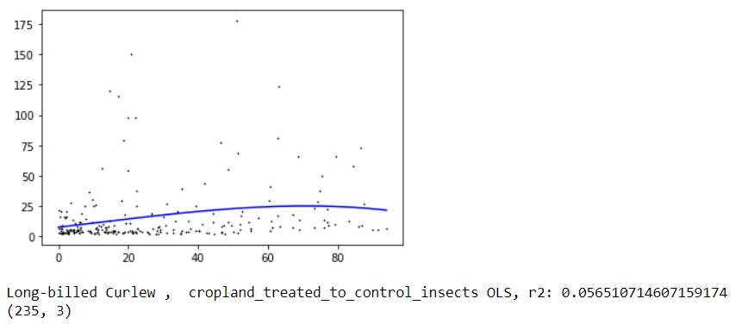
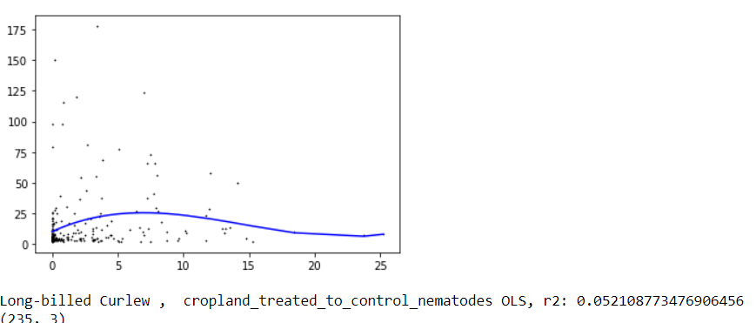
Chemical Use: Selected LR Results

Slide 12
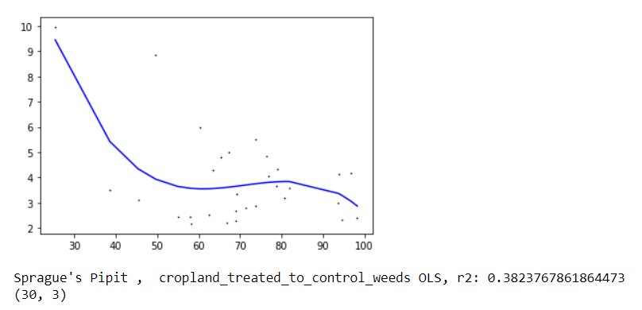
Chemical Use: Selected LR Results

Slide 13
Chemical Use: Result Discussion
The correlation analysis confirmed the relationship between cropland treated to control insects and observation count, however regression performed poorly in all species cases. Best performing use-case was Long-Billed Curlew (r2 0.06).
The correlation analysis also confirmed a relationship between cropland treated to control weeds/grasses, but again regression performed quite poorly in most species' cases. Exception of Sprague’s Pipit (r2 0.38).
An interesting hidden pattern?
Observation: Long-Billed Curlew had strongest positive correlation with cropland treated to control nematodes. Cropland treated to control nematodes had slightly higher total observations of Long-Billed Curlew
A literature search confirmed that nematodes are the most consistent disease-causing parasite of the Long-billed Curlew. Linear regression for these two features was among the best performing (relatively) of the sample set.
Takeaway:
Species such as long-billed curlew rely heavily on insects as a source of food. In areas where species such as this have their highest population densities and known breeding sites, farmers should limit the use of insecticides to prevent further decline.
Species such as Sprague’s Pipit, Upland Sandpiper, and Baird’s Sparrow rely heavily on dense shrubbery for their breeding habitat and cover. Areas with high population densities should be preserve as much of this habitat as possible by not using chemicals to control grasses and weeds where feasible to prevent decline.
https://www.fs.usda.gov/Internet/FSE_DOCUMENTS/stelprdb5182037.pdf

Slide 14
Core Question 3: Existing Efforts
Do counties with higher rates of agricultural land enrolled in conservation programs have larger populations of grassland-dependent species?
Impact: understanding whether conservation efforts have made an observable impact on species populations based on existing eBird data
Approach: linear regression
Hypothesis Development
A relationship may exist between percentage of land reported as enrolled in conservation efforts vs species populations in that county.

Slide 15
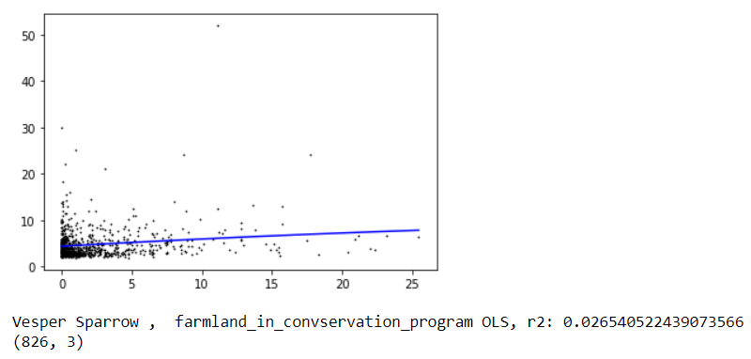
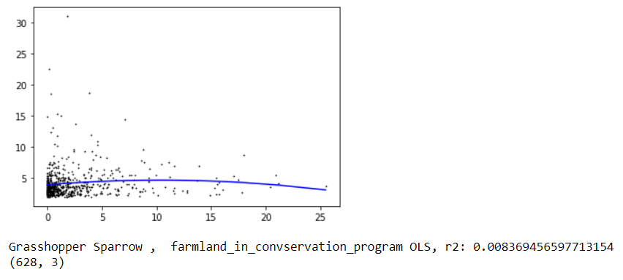
Existing Conservation Efforts: Selected Results

Slide 16
Existing Conservation Efforts: Results
Result: Inconclusive
There were no significant patterns identified in the data following linear regression analysis.
OLS, Lasso, and Ridge regression failed to predict relationships
Root Causes:
Bias in the data: areas with higher conservation had less observations reported on eBird due to lower human population (less citizen scientists) ***
There is no impact on conservation efforts
Temporal data beyond a single year is needed to draw a rational conclusion

Slide 17
Core Question 4: Population Networks
4. Are there clusters of grassland-dependent species that appear most frequently together?
Impact: Understanding which species occur most frequently together could help steer more granular conservation efforts
Approach: network analysis (song sparrow, house sparrow, red-winged blackbird omitted from analysis due to being ubiquitous)
Hypothesis Development:
Species which prefer pastureland will occur with strongest links in the network
Possible relationships will emerge with species that prefer areas with agricultural land as cropland

Slide 18
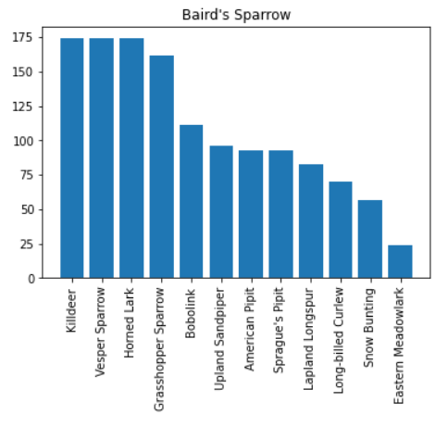
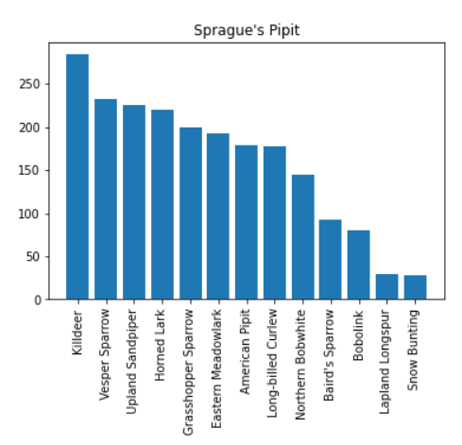
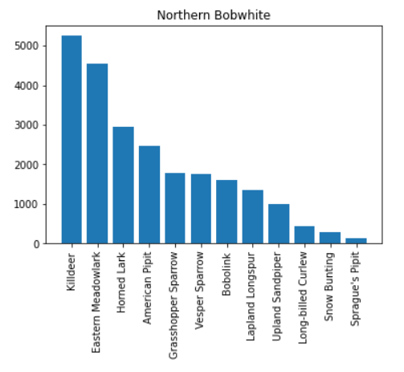
Population Networks: Selected Results

Slide 19
Population Networks : Discussion
Killdeer scored highest in nearly all species networks due to having an extremely wide range and healthy population size.
Vesper Sparrow scored highest next to Killdeer for the Baird’s Sparrow similarity network. Both species highly prefer pastureland, confirming the initial hypothesis.
Vesper Sparrow and Upland Sandpiper scored high with the Sprague’s Pipit similarity network. All three species highly prefer pastureland, adding further confirmation to the initial hypothesis.
Northern Bobwhite scored highest with Eastern Meadowlark and Horned Lark, which had weak correlations suggesting preference for land in farms.
Takeaway: the above similarity networks could be leveraged to decide which species could be targeted concurrently for conservation efforts. For example, Vesper Sparrow and Baird’s Sparrow have been shown to share significant habitat. Is there possibility of streamlining conservation efforts?

Slide 20
Limitations and Future Work
Bias:
Limitation of eBird data in terms of checklists geographically
Limitation of having no temporal component to data – migration is seasonal
Limitation of only having 16 species. Ideally would have full species data
Next Steps:
Improve dataset to account for additional species and years
Census occurs every 5 years: 2022 data coming soon – opportunity for time series

